Slide 1
Aug/Sep 2026 EVV Training

Slide 2
Agenda
01
04
Electronic Visit Verification (EVV)
What is changing?
Time4Care mobile app
IVR
FAQ’s
Questions
02
05
03
06

Slide 3
Electronic Visit Verification (EVV)
01

Slide 4
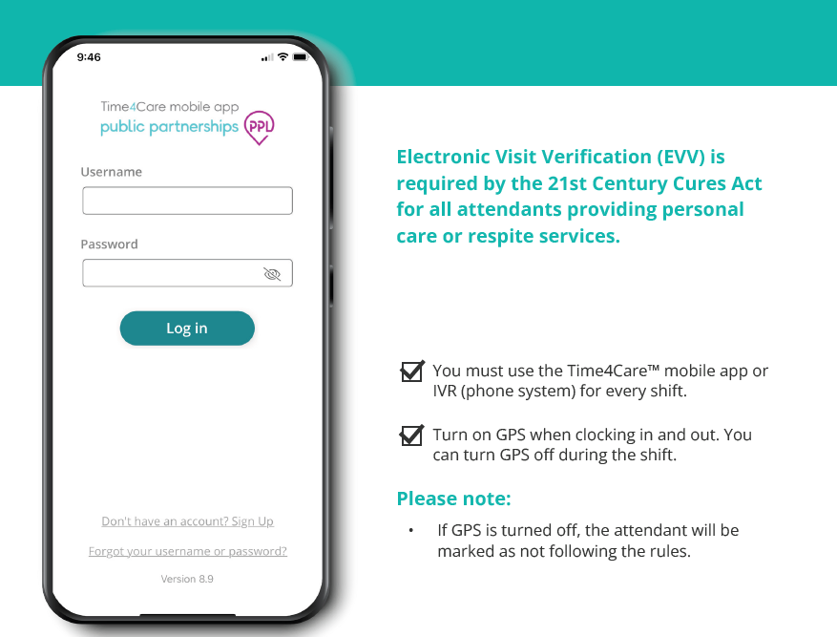
Electronic Visit Verification (EVV)

Slide 5
What is changing?
02

Slide 6
What is changing and for who?
Question | Answer
Who? | Attendants who live with the member they care for (Live-In)
What? | Live-In attendants are now required to use PPL’s Time4Care mobile app or the phone system (IVR) to enter all their shifts.
When? | Starting October 1, 2026, all attendants regardless of live-in status will be required to use an approved Electronic Visit Verification (EVV) method to submit all shifts.

Slide 7
Time4Care™ app
03

Slide 8
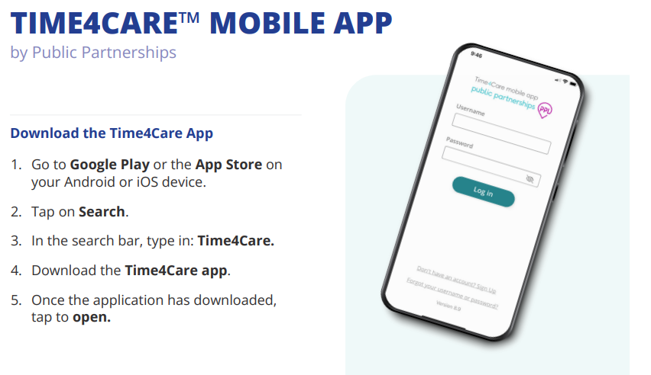
Time4Care™ mobile app
Time4Care™ mobile app is PPL’s time submission platform.

Slide 9
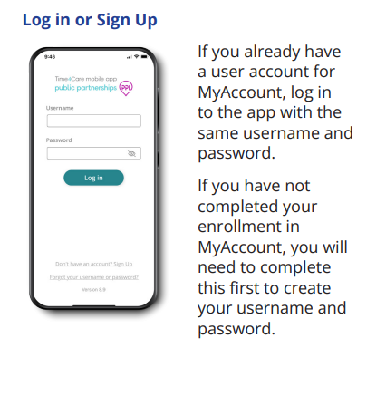
Time4Care™ mobile app- cont’d

Slide 10

Time4Care™ mobile app- cont’d
Reminder: You must turn on GPS when clocking in and out. You can turn GPS off during the shift.
If GPS is turned off while clocking in or out, the attendant will be marked as not following the rules.

Slide 11
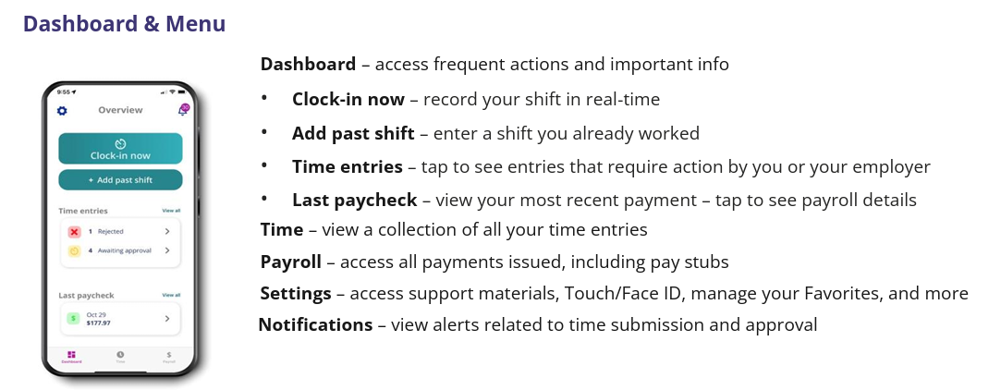
Time4Care™ mobile app- cont’d

Slide 12

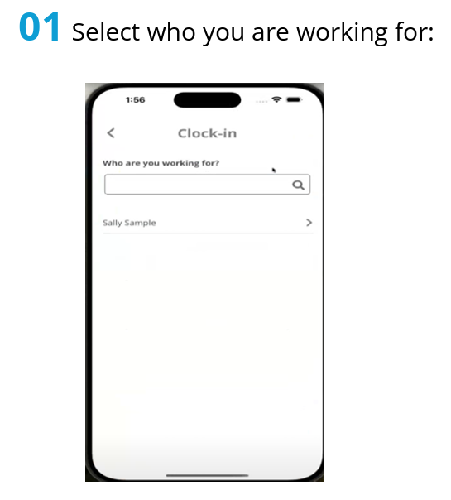
Time4Care™ mobile app- cont’d

Slide 13
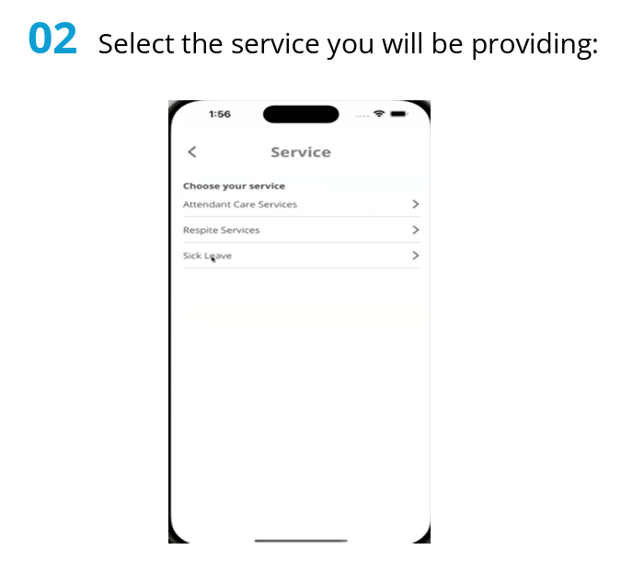
Time4Care™ mobile app- cont’d

Slide 14
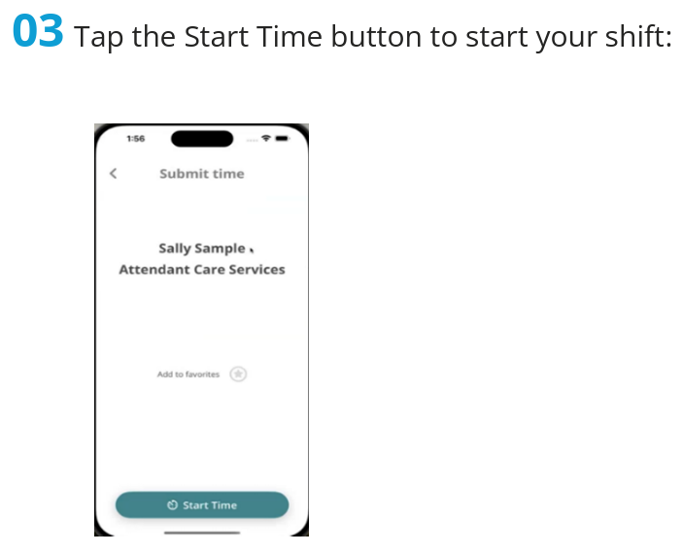
Time4Care™ mobile app- cont’d

Slide 15
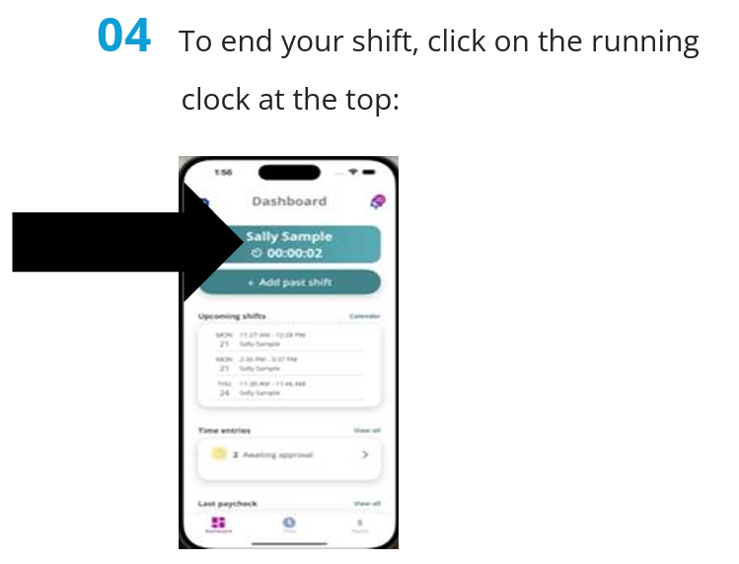
Time4Care™ mobile app- cont’d

Slide 16
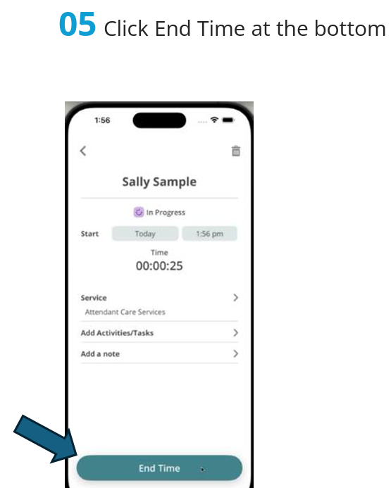
Time4Care™ mobile app- cont’d

Slide 17
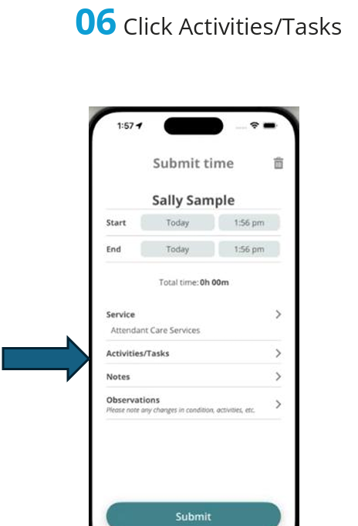
Time4Care™ mobile app- cont’d

Slide 18
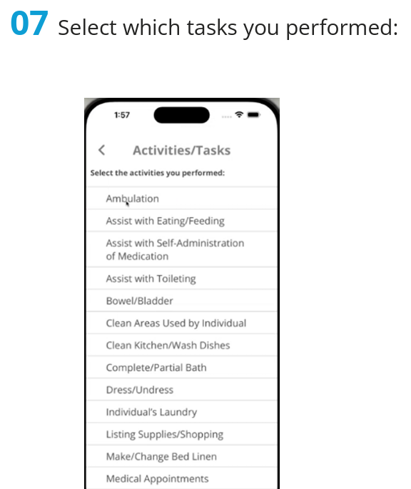
Time4Care™ mobile app- cont’d

Slide 19
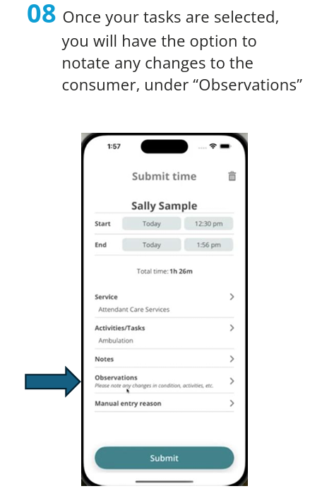
Time4Care™ mobile app- cont’d

Slide 20
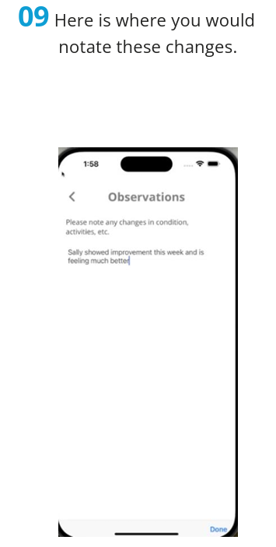
Time4Care™ mobile app- cont’d

Slide 21
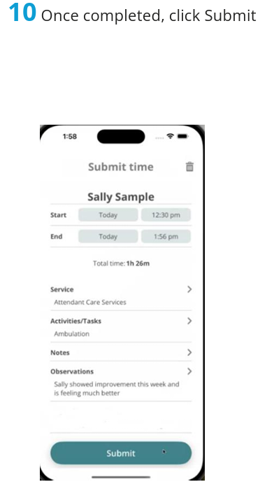
Time4Care™ mobile app- cont’d

Slide 22
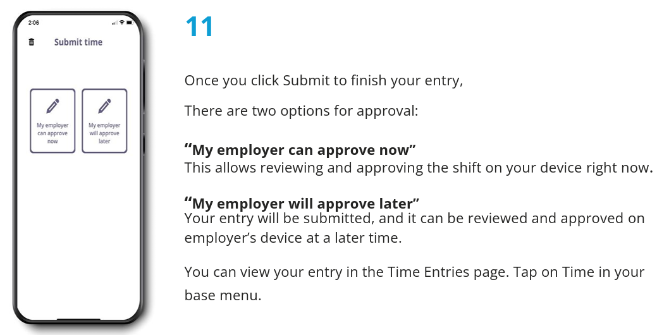
Time4Care™ mobile app- cont’d

Slide 23
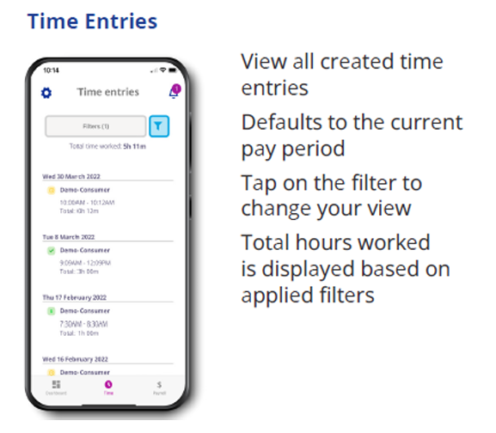
Time4Care™ mobile app- cont’d

Slide 24
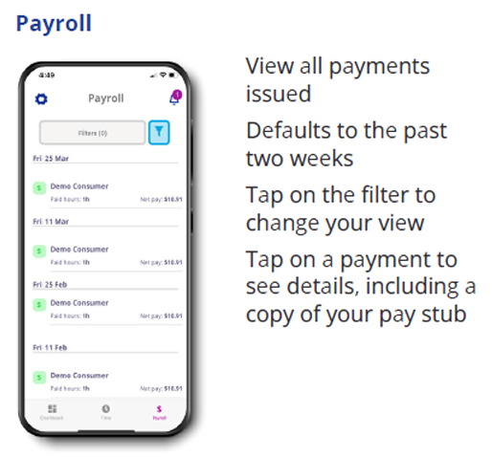
Time4Care™ mobile app- cont’d

Slide 25
Time4Care™ app- Employer
03

Slide 26
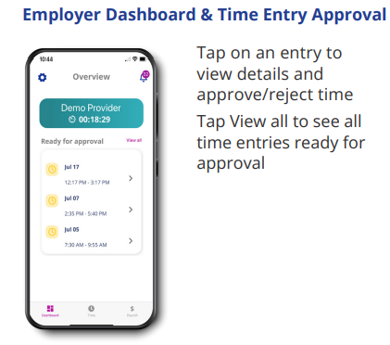
Time4Care™ mobile app- cont’d

Slide 27
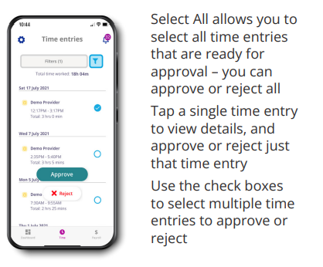
Time4Care™ mobile app- cont’d

Slide 28
IVR/Telephony
04

Slide 29
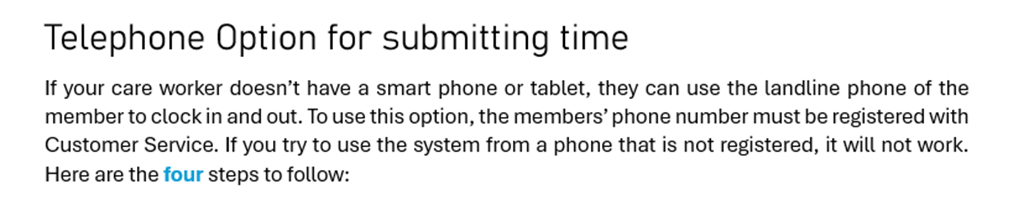
IVR/Telephony
IVR (Interactive Voice Response)/Telephony is the alternative option to submit time entries via landline from the member’s residence.
Telephone Option for submitting time
If your attendant does not have a smart phone or tablet, they can use the landline phone of the member to clock in and out. To use this option, the member’s phone number must be registered with Customer Service. If you try to use the system from a phone that is not registered, it will not work. Here are the four steps to follow:
attendant
01
Phone Line Registration
Before using the phone to manage the Attendant’s time (or to log time if you are the Attendant) first call Customer Service to register the member’s landline phone. Customer Service can be reached at 833-549-5672.
Attendant’s
Attendant)

Slide 30
IVR/Telephony- cont’d
02
Submitting and Approving Shifts
To submit a shift as an Attendant, or to approve/reject a shift as a member, call 833-204-9047.

Slide 31
IVR/Telephony- cont’d
03
The Attendant will
Call 833-204-9047
Enter the last four digits of their social security number and their date of birth
Select the member from the list
Follow the prompts to start a shift, modify, or end an existing shift
If needed, follow the prompts to correct and resubmit shifts
Attendant

Slide 32
Task Documentation
Complete/Partial Bath
Dress/Undress
Assist with Toileting
Transferring
Personal Grooming
Assist Eating/Feeding
Ambulation
Turn/Change Position
Vital Signs
Assist with Self-Administration of Medication
Bowel/Bladder
Wound Care
Range of Motion
Supervision
Prepare Breakfast
Prepare Lunch
Prepare Dinner
Clean Kitchen/Wash Dishes
Make/Change Bed Linen
Clean Areas Used by Individual
Listing Supplies/Shopping
Individual's Laundry
Medical Appointments
Work/School/Social
Other - Describe
Attendants will have to select any and all tasks completed during each shift.

Slide 33
IVR/Telephony- cont’d
04
The Employer of Record will
Call 833-204-9047
Enter the last four digits of their social security number and their date of birth
Select the member from the list
Follow the prompts to review, approve, or reject submitted shifts

Slide 34
FAQs
05

Slide 35
FAQs- Frequently Asked Questions
I am a live-in attendant do I need to be EVV-compliant? Yes. All attendants need to be EVV-compliant, which includes live-in attendants and non-live-in attendants.
Do I need to use the Time4Care™ app? Yes, Time4Care™ is Public Partnerships mobile EVV application. You can download Time4Care™ from the Apple App Store or the Google Play Store on your mobile device.
How does it work? Time4Care™ uses a clock to record your start time and end time for each shift worked. The app uses GPS to record your location at clock in and clock out only. It does not record your location at any other time.
How does the app work if I do not have internet access? The app continues to work offline and will still record your time and location. When your device is in an area with internet access your offline entries will upload.
For the full list of FAQ’s, please click below for the link to PPL’s website:
PPL EVV FAQs

